Slide 1
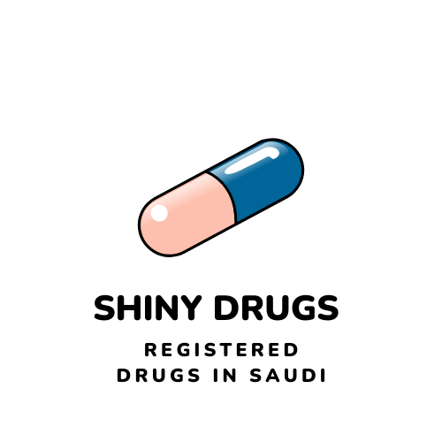
SFDA drugs dataset Analysis with Shiny App
By FATIMAH ALAMER, 20/11/2021

Slide 2

Why SFDA drugs dataset?

Slide 3

The source the data
SFDA website

Slide 4
Starting Capstone
markdown
Shiny markdown
Shiny app
Notes:
© Copyright PresentationGO.com – The free PowerPoint and Google Slides template library

Slide 5
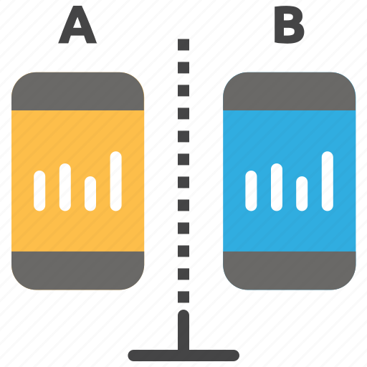

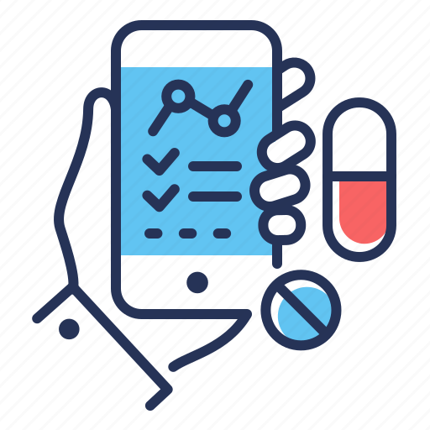
Comparing between SA & Non SA drugs
Research problem
Finding our dependency
Shiny App

Slide 6
Structure of the Data
Data: 7635 * 37
Register Number | Scientific Name Arabic | Administration Route | Package Size
Register Year | Trade Name | AtcCode1 | Legal Status
Product type | Trade Name Arabic | AtcCode2 | Product Control
Drug Type | Strength | Size | Distribute area
Sub-Type | Strength Unit | Size Unit | Public price
Scientific Name | Pharmaceutical Form | Package Types | Marketing Company
shelf Life | Marketing Country | Manufacture Name | Manufacture Name
Storage conditions | Manufacture Country | Authorization Status | Marketing Status
Main agent | Second agent | Third agent | 2Manufacture Name

Slide 7
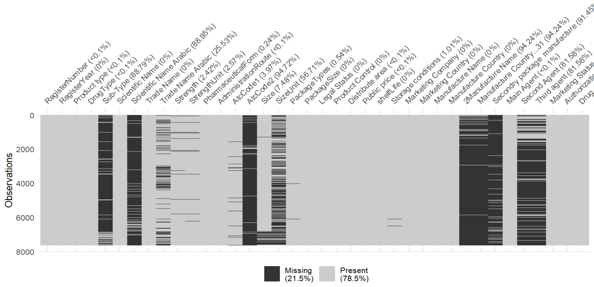
Missing Data

Slide 8
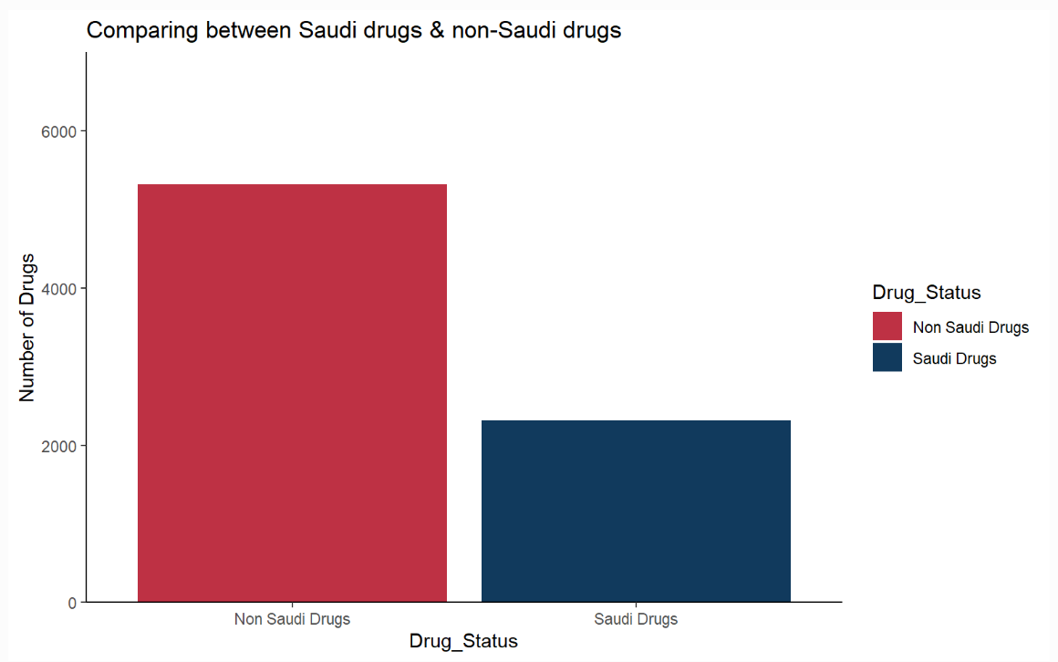

Slide 9
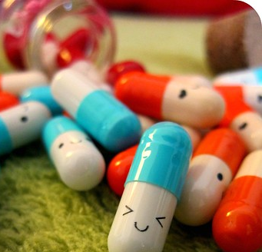
Issues with Finding Unique Drugs!
ATCode
Scientific name
There is 24% unique drugs

Slide 10
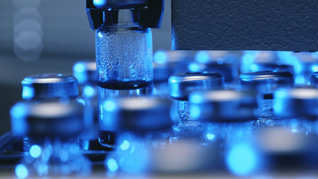

Finding Exclusive drugs
222 drugs are synthesized exclusively locally.
70% of unique drugs are synthesized only outside SA,

Slide 11
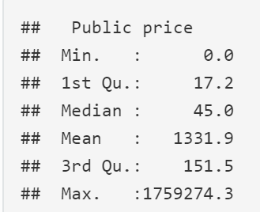
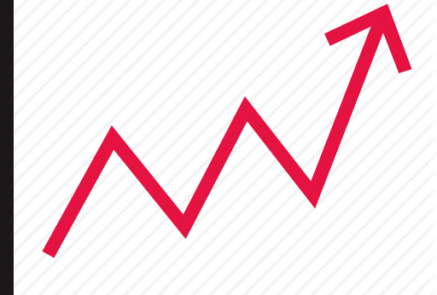
Comparing Prices
Plotting Issues with extreme values !

Slide 12
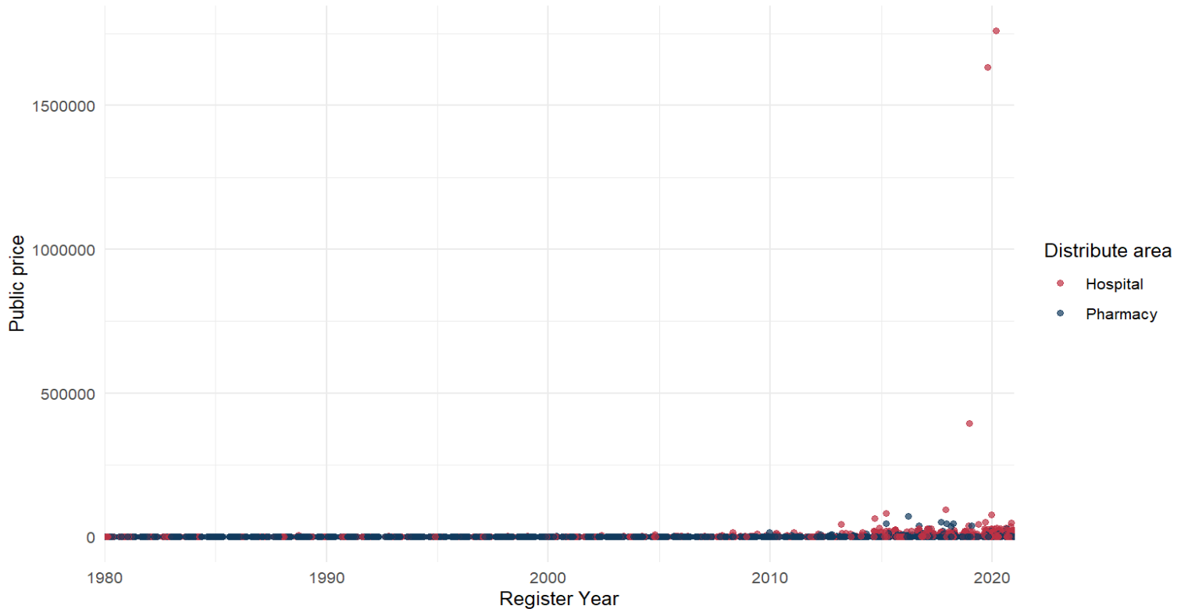
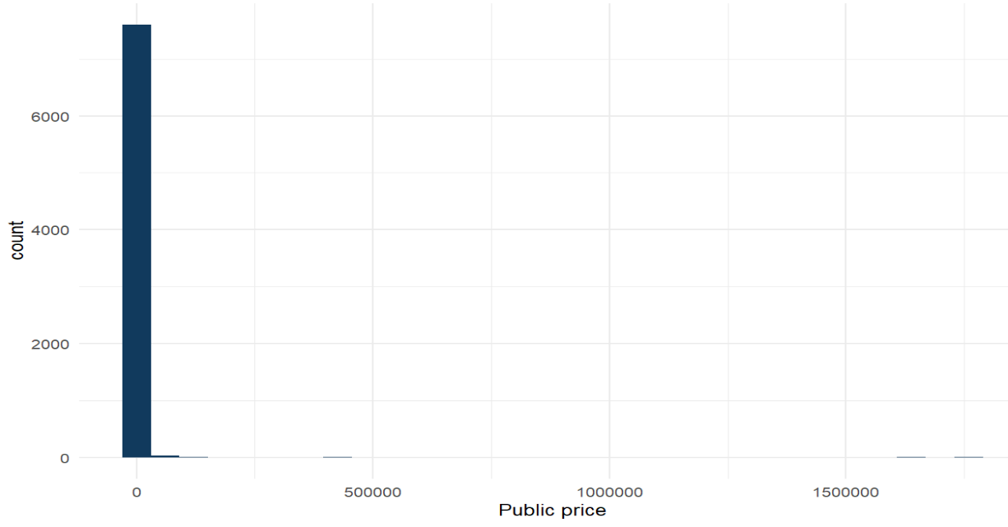
Plotting Issues with extreme values !

Slide 13
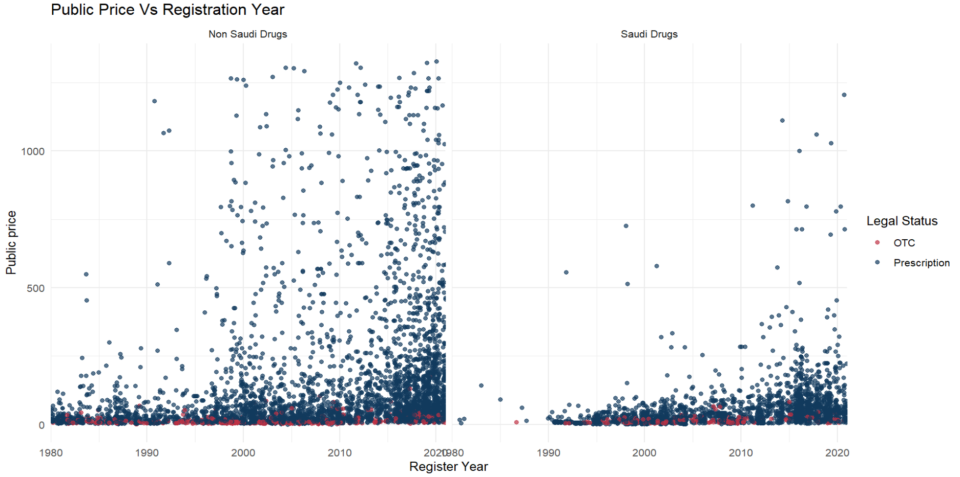

Prices vs registration year

Slide 14


Better Solution for plotting issues
Can I present all 7635 drugs in one plot with minimizing overlapping and avoiding transforming?
Let’s go to shiny app
Shiny Drugs: Registered Drugs in Saudi (shinyapps.io)

Slide 15
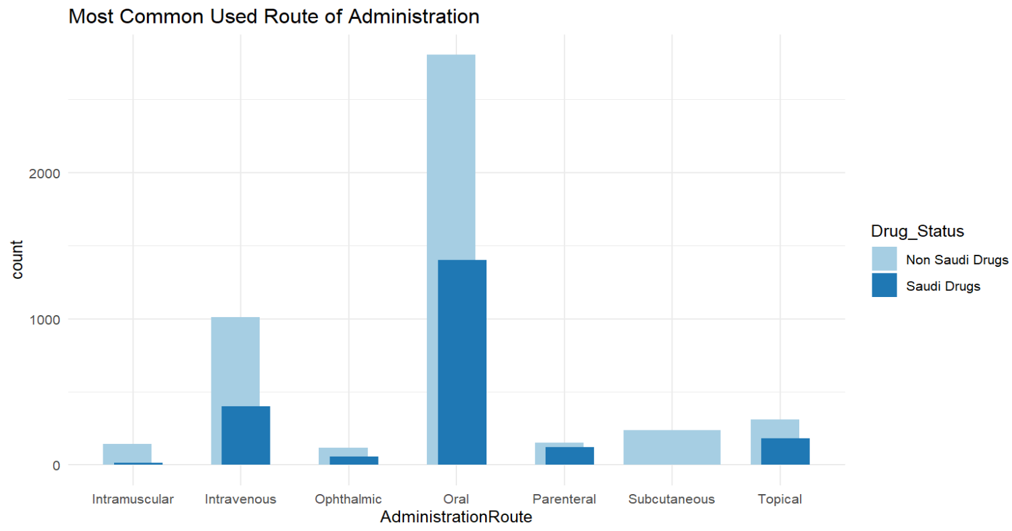

Slide 16

Finding Trends

Slide 17
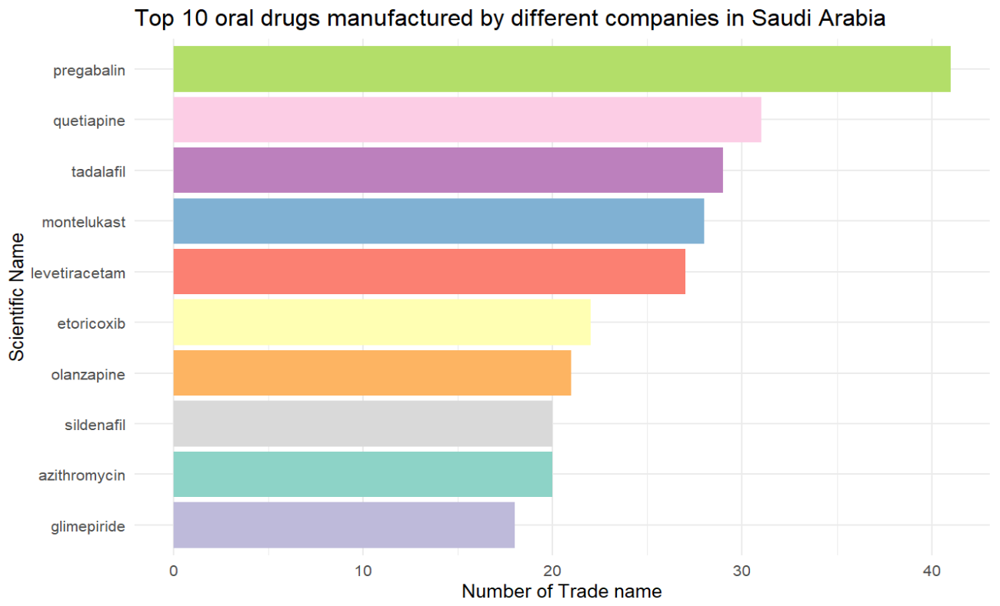
anticonvulsant, anxiolytic, antipsychotic, neuropathic pain, chronic pain
Antipsychotics & antidepressant
Impotence, Pulmonary hypertension
Asthma and Allergic
anti-seizure
Anti-inflammatory, painkiller
Antipsychotics & antidepressant
Impotence, Pulmonary hypertension
antibiotics
anti-diabetic

Slide 18
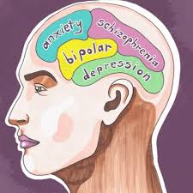
Mental Health Status in Saudi

Slide 19
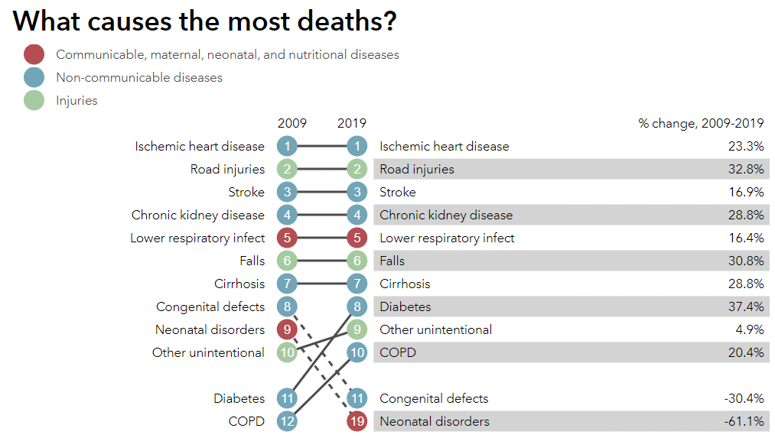
Most Common Death in Saudi Arabia
Source: Saudi Arabia | Institute for Health Metrics and Evaluation (healthdata.org)

Slide 20




Conclusion
Increase Heart disease
opportunity for Saudi pharmaceutical companies
Dependency is high
Increase mental issues

Slide 21


Take care of your self!
Healthy lifestyle is the most potent medicine at your disposal

Slide 22
Access links
SFDA drug Shiny app:
Shiny Drugs: Registered Drugs in Saudi (shinyapps.io)
SFDA Drug Analysis HTML markdown
Shiny Drugs: SFDA Drugs Dataset Analysis (fatimahalamer.github.io)

Slide 23



Thank you
Rick Scavetta
Lujain Felemban
My colleagues

